Slide 1
Recurrent Neural Networks (RNNs)

Slide 2
Convolution Neural Networks
Key Shortcomings:
Take fixed size input and produce fixed size output. Can’t handle variable size inputs and outputs, desirable in many applications such as video processing, text processing and speech processing
Can’t model relationship between instances, desirable in many applications such as video processing
Only bounded context in handle, not suitable for certain applications such as video and speech processing

Slide 3
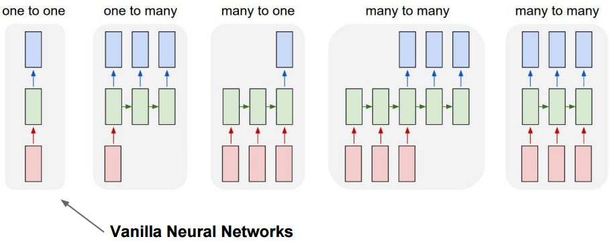
Typical RNNs Applications

Slide 4
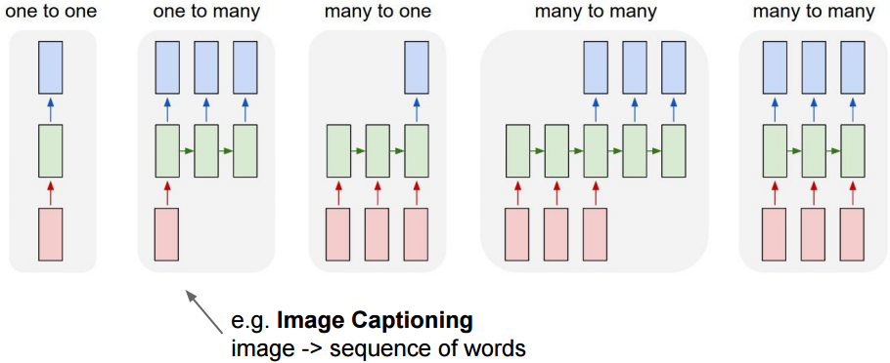
Typical RNNs Applications

Slide 5
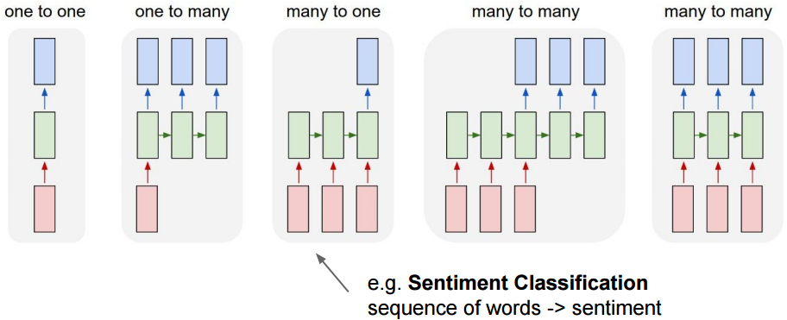
Typical RNNs Applications

Slide 6
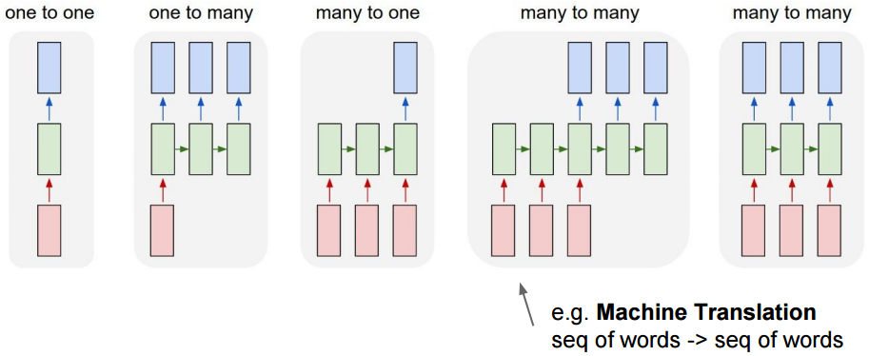
Typical RNNs Applications

Slide 7
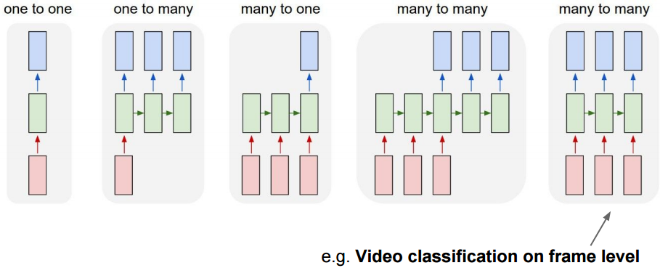
Typical RNNs Applications

Slide 8
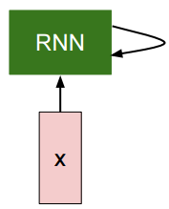
Recurrent Neural Networks

Slide 9
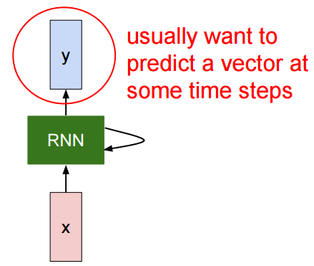
Recurrent Neural Networks

Slide 10
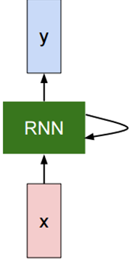
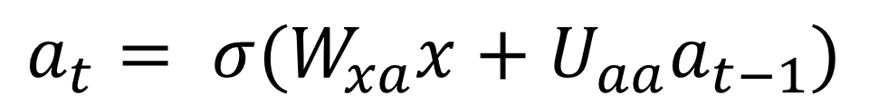
Recurrent Neural Networks: State Computation
$$a_{t}= σ(W_{xa}x+U_{aa}a_{t−1})$$
State is updated at each time step

Slide 11
Recurrent Neural Networks: State Computation
Input weights
State weights
$$a_{t}= σ(W_{xa}x+U_{aa}a_{t−1})$$
New state
Sigmoid
Input
Old state

Slide 12
Recurrent Neural Networks: State Computation
Input weights
State weights
$$a_{t}= σ(W_{xa}x+U_{aa}a_{t−1})$$
New state
Sigmoid
Input
Old state
Note: Same function and same matrices are used at every time step

Slide 13
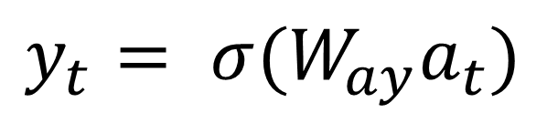
Recurrent Neural Networks: Output Computation
$$a_{t}= σ(W_{xa}x+U_{aa}a_{t−1})$$
$$y_{t}= σ(W_{ay}a_{t})$$

Slide 14
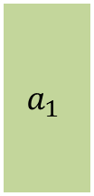
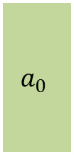
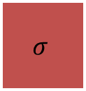
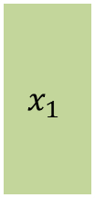
Recurrent Neural Networks: Computational Graph
$$a_{0}$$
$$a_{1}$$
$$σ$$
$$x_{1}$$

Slide 15

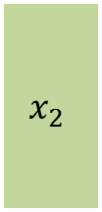
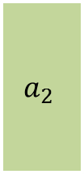
Recurrent Neural Networks: Computational Graph
$$a_{0}$$
$$a_{1}$$
$$a_{2}$$
$$σ$$
$$σ$$
$$x_{1}$$
$$x_{2}$$

Slide 16

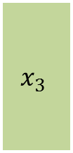
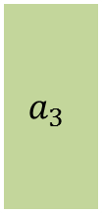
Recurrent Neural Networks: Computational Graph
$$a_{0}$$
$$a_{1}$$
$$a_{2}$$
$$a_{3}$$
$$σ$$
$$σ$$
$$σ$$
$$x_{1}$$
$$x_{2}$$
$$x_{3}$$

Slide 17
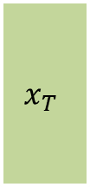


Recurrent Neural Networks: Computational Graph
$$a_{0}$$
$$a_{1}$$
$$a_{2}$$
$$a_{3}$$
$$a_{T}$$
$$σ$$
$$σ$$
$$σ$$
$$σ$$
$$x_{1}$$
$$x_{2}$$
$$x_{3}$$
$$x_{T}$$

Slide 18


Recurrent Neural Networks: Computational Graph
$$W_{aa}$$
$$a_{0}$$
$$a_{1}$$
$$a_{2}$$
$$a_{3}$$
$$a_{T}$$
$$σ$$
$$σ$$
$$σ$$
$$σ$$
$$x_{1}$$
$$x_{2}$$
$$x_{3}$$
$$x_{T}$$
$$W_{xa}$$
Note: Reusing weight matrices at each time step

Slide 19
Recurrent Neural Networks: Computational Graph
$$W_{aa}$$
$$a_{0}$$
$$a_{1}$$
$$a_{2}$$
$$a_{3}$$
$$a_{T}$$
$$σ$$
$$σ$$
$$σ$$
$$σ$$
$$x_{1}$$
$$x_{2}$$
$$x_{3}$$
$$x_{T}$$
$$W_{xa}$$

Slide 20


Recurrent Neural Networks: Computational Graph
$$W_{aa}$$
$$a_{0}$$
$$a_{1}$$
$$a_{2}$$
$$a_{3}$$
$$a_{T}$$
$$σ$$
$$σ$$
$$σ$$
$$σ$$
$$x_{1}$$
$$x_{2}$$
$$x_{3}$$
$$x_{T}$$
$$W_{xa}$$

Slide 21

Recurrent Neural Networks: Computational Graph
$$W_{aa}$$
$$a_{0}$$
$$a_{1}$$
$$a_{2}$$
$$a_{3}$$
$$a_{T}$$
$$σ$$
$$σ$$
$$σ$$
$$σ$$
$$x_{1}$$
$$x_{2}$$
$$x_{3}$$
$$x_{T}$$
$$W_{xa}$$

Slide 22
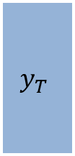
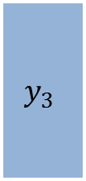
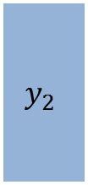
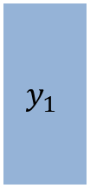
Recurrent Neural Networks: Many to Many
$$y_{1}$$
$$y_{2}$$
$$y_{3}$$
$$y_{T}$$
$$a_{0}$$
$$a_{1}$$
$$a_{2}$$
$$a_{3}$$
$$a_{T}$$
$$σ$$
$$σ$$
$$σ$$
$$σ$$
$$x_{1}$$
$$x_{2}$$
$$x_{3}$$
$$x_{T}$$

Slide 23

Recurrent Neural Networks: Many to Many
$$y_{1}$$
$$y_{2}$$
$$y_{3}$$
$$y_{T}$$
$$W_{ay}$$
$$a_{0}$$
$$a_{1}$$
$$a_{2}$$
$$a_{3}$$
$$a_{T}$$
$$σ$$
$$σ$$
$$σ$$
$$σ$$
$$x_{1}$$
$$x_{2}$$
$$x_{3}$$
$$x_{T}$$

Slide 24
Recurrent Neural Networks: Many to Many
$$y_{1}$$
$$y_{2}$$
$$y_{3}$$
$$y_{T}$$
$$W_{ay}$$
$$a_{0}$$
$$a_{1}$$
$$a_{2}$$
$$a_{3}$$
$$a_{T}$$
$$σ$$
$$σ$$
$$σ$$
$$σ$$
$$x_{1}$$
$$x_{2}$$
$$x_{3}$$
$$x_{T}$$

Slide 25

Recurrent Neural Networks: Many to Many
$$y_{1}$$
$$y_{2}$$
$$y_{3}$$
$$y_{T}$$
$$W_{ay}$$
$$a_{0}$$
$$a_{1}$$
$$a_{2}$$
$$a_{3}$$
$$a_{T}$$
$$σ$$
$$σ$$
$$σ$$
$$σ$$
$$x_{1}$$
$$x_{2}$$
$$x_{3}$$
$$x_{T}$$

Slide 26
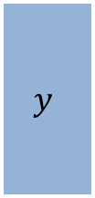
Recurrent Neural Networks: Many to One
$$y$$
$$a_{0}$$
$$a_{1}$$
$$a_{2}$$
$$a_{3}$$
$$a_{T}$$
$$σ$$
$$σ$$
$$σ$$
$$σ$$
$$x_{1}$$
$$x_{2}$$
$$x_{3}$$
$$x_{T}$$

Slide 27



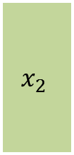


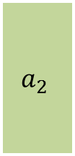



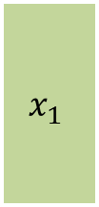
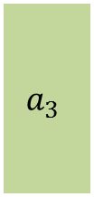

Recurrent Neural Networks: Sequence to Sequence Models
$$a_{0}$$
$$a_{1}$$
$$a_{2}$$
$$a_{3}$$
$$a_{T}$$
$$σ$$
$$σ$$
$$σ$$
$$σ$$
$$x_{1}$$
$$x_{2}$$
$$x_{3}$$
$$x_{T}$$
Many to One Network

Slide 28
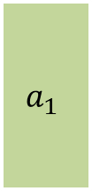
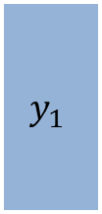





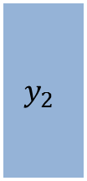
Recurrent Neural Networks: Sequence to Sequence Models
$$a_{0}$$
$$a_{1}$$
$$a_{2}$$
$$a_{3}$$
$$a_{T}$$
$$σ$$
$$σ$$
$$σ$$
$$σ$$
$$x_{1}$$
$$x_{2}$$
$$x_{3}$$
$$x_{T}$$
$$y_{3}$$
$$y_{2}$$
$$y_{1}$$
$$a_{3}$$
$$a_{2}$$
$$a_{1}$$
$$σ$$
$$σ$$
$$σ$$
One to Many Network

Slide 29




Recurrent Neural Networks: Sequence to Sequence Models
$$W_{aa}$$
$$a_{0}$$
$$a_{1}$$
$$a_{2}$$
$$a_{3}$$
$$a_{T}$$
$$σ$$
$$σ$$
$$σ$$
$$σ$$
$$x_{1}$$
$$x_{2}$$
$$x_{3}$$
$$x_{T}$$
$$W_{xa}$$
$$y_{3}$$
$$y_{2}$$
$$y_{1}$$
$$W_{ay}$$
$$a_{3}$$
$$a_{2}$$
$$a_{1}$$
$$σ$$
$$σ$$
$$σ$$
$$W_{aa}$$

Slide 30




Recurrent Neural Networks: Sequence to Sequence Models
$$W_{aa}$$
$$a_{0}$$
$$a_{1}$$
$$a_{2}$$
$$a_{3}$$
$$a_{T}$$
$$σ$$
$$σ$$
$$σ$$
$$σ$$
$$x_{1}$$
$$x_{2}$$
$$x_{3}$$
$$x_{T}$$
$$W_{xa}$$
$$y_{3}$$
$$y_{2}$$
$$y_{1}$$
$$W_{ay}$$
$$a_{3}$$
$$a_{2}$$
$$a_{1}$$
$$σ$$
$$σ$$
$$σ$$
$$W_{aa}$$

Slide 31


Recurrent Neural Networks: Sequence to Sequence Models
$$W_{aa}$$
$$a_{0}$$
$$a_{1}$$
$$a_{2}$$
$$a_{3}$$
$$a_{T}$$
$$σ$$
$$σ$$
$$σ$$
$$σ$$
$$x_{1}$$
$$x_{2}$$
$$x_{3}$$
$$x_{T}$$
$$W_{xa}$$
$$y_{3}$$
$$y_{2}$$
$$y_{1}$$
$$W_{ay}$$
$$a_{3}$$
$$a_{2}$$
$$a_{1}$$
$$σ$$
$$σ$$
$$σ$$
$$W_{aa}$$

Slide 32
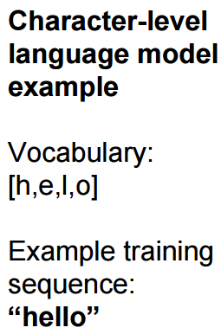
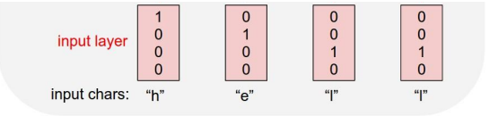
Recurrent Neural Networks: Language Modeling

Slide 33








Example: Character-Level Language Modeling
$$a_{T}$$
$$σ$$
$$σ$$
$$σ$$
$$σ$$
0 0 0
0.3 -0.1 0.9
1.0 0.3 0.1
1.0 -0.5 -0.3
1 0 0 0
0 1 0 0
0 0 1 0
0 0 1 0
“h”
“e”
“l”
“l”
$$a_{t}= σ(W_{xa}x+U_{aa}a_{t−1})$$

Slide 34

Example: Character-Level Language Modeling
What is size of $W_{xa}$ and $U_{aa}$?
$$a_{T}$$
$$σ$$
$$σ$$
$$σ$$
$$σ$$
0 0 0
0.3 -0.1 0.9
1.0 0.3 0.1
1.0 -0.5 -0.3
1 0 0 0
0 1 0 0
0 0 1 0
0 0 1 0
“h”
“e”
“l”
“l”
$$a_{t}= σ(W_{xa}x+U_{aa}a_{t−1})$$

Slide 35
Example: Character-Level Language Modeling
“e”
“l”
0.1 0.2 0.3 0.4
0.1 0.2 0.6 0.1
$$a_{T}$$
$$σ$$
$$σ$$
$$σ$$
$$σ$$
0 0 0
0.3 -0.1 0.9
1.0 0.3 0.1
1.0 -0.5 -0.3
1 0 0 0
0 1 0 0
0 0 1 0
0 0 1 0
“h”
“e”
“l”
“l”
$$a_{t}= σ(W_{xa}x+U_{aa}a_{t−1})$$

Slide 36

Example: Character-Level Language Modeling
At test-time sample characters one at a time, feed back to model

Slide 37

Example: Character-Level Language Modeling
At test-time sample characters one at a time, feed back to model

Slide 38

Example: Character-Level Language Modeling
At test-time sample characters one at a time, feed back to model

Slide 39
Example: Character-Level Language Modeling
At test-time sample characters one at a time, feed back to model

Slide 40

Example: Character-Level Language Modeling
At test-time sample characters one at a time, feed back to model

Slide 41

Recurrent Neural Networks: Language Modeling

Slide 42

Recurrent Neural Networks: Language Modeling

Slide 43

Recurrent Neural Networks: Language Modeling

Slide 44

Recurrent Neural Networks: Language Modeling

Slide 45

Recurrent Neural Networks: Language Modeling

Slide 46

Recurrent Neural Networks: Language Modeling

Slide 47

Recurrent Neural Networks: Language Modeling

Slide 48
Reading Homework
Read paper “Deep Learning” published in Nature.

